Slide 1
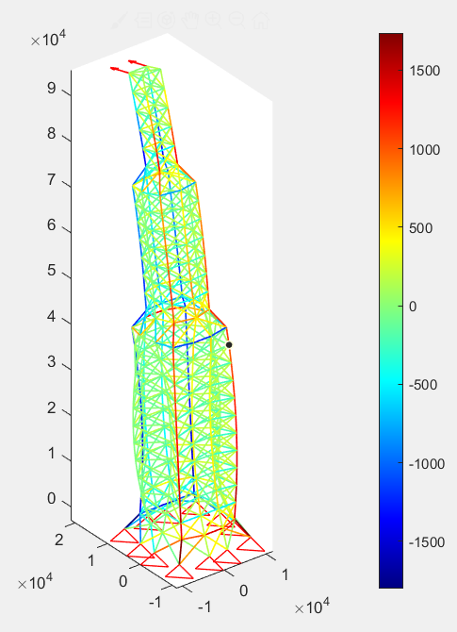
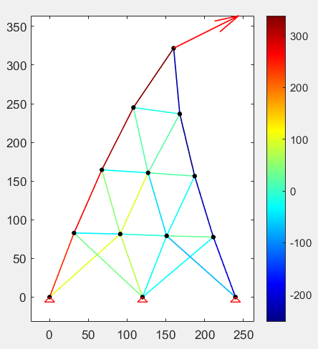
桁架结构2D/3D——Matlab有限元编程
坐标变化矩阵
单元刚度矩阵
整体刚度矩阵-组装
边界条件施加-乘大数法
平面桁架2DTruss
三维桁架3DTruss

Slide 2
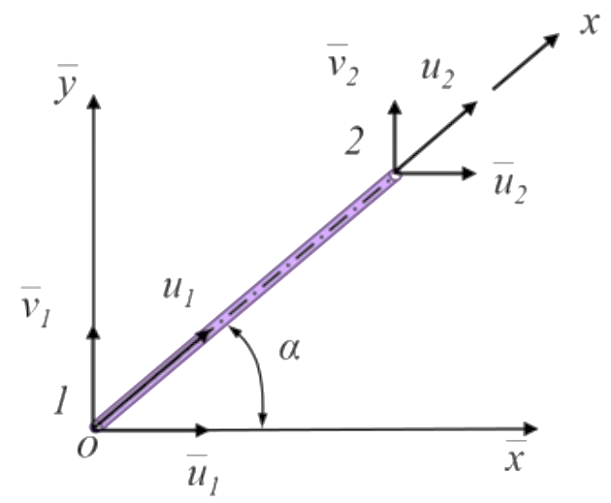
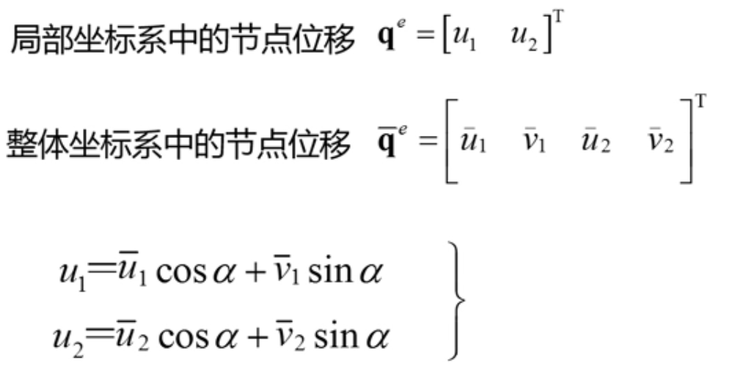
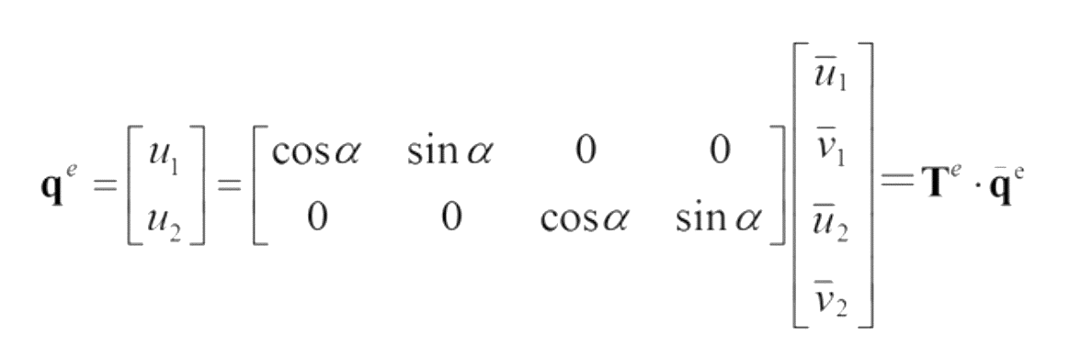
坐标变换矩阵 CoordTransform()
%局部坐标与全局坐标的转换函数
function [R]=CoordTransform(x,y,BarLength)
l=(x(2)-x(1))/BarLength; m=(y(2)-y(1))/BarLength;
R=[l m 0 0;0 0 l m];
end

Slide 3
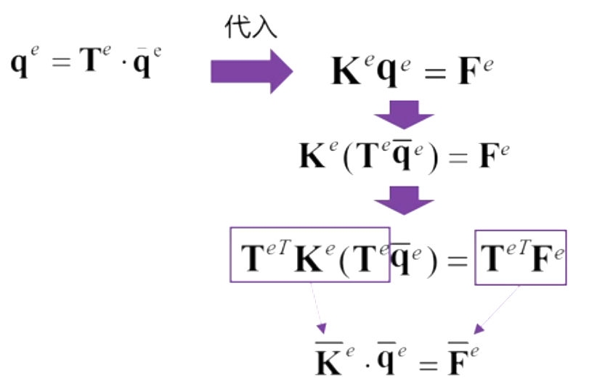
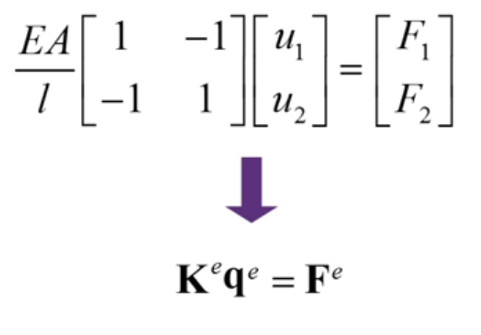
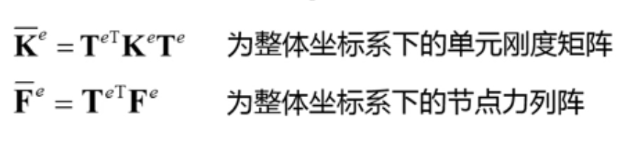
单元刚度矩阵 BarElementKe()
%计算单元刚度矩阵函数
function [Ke] = BarElementKe(A,E,R,BarLength)
ke=A*E/BarLength*[1 -1;-1 1];
Ke=R'*ke*R;
end
%局部坐标与全局坐标的转换函数
function [R]=CoordTransform(x,y,BarLength)
l=(x(2)-x(1))/BarLength; m=(y(2)-y(1))/BarLength;
R=[l m 0 0;0 0 l m];
end
局部坐标系-单元刚度方程
整体坐标系-单元刚度方程

Slide 4

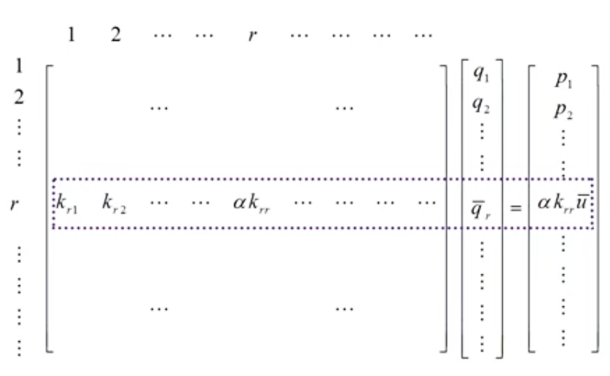
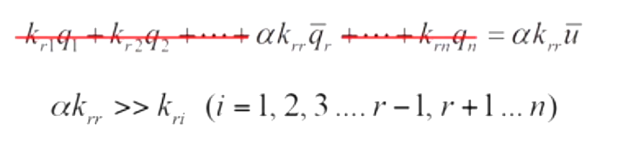


整体刚度矩阵+边界条件施加（乘大数法）
零边界/非零边界
%n1，n2为该单元的两个节点的编号
K(2*n1-1:2*n1,2*n1-1:2*n1)=K(2*n1-1:2*n1,2*n1-1:2*n1)+ke(1:2,1:2);
K(2*n1-1:2*n1,2*n2-1:2*n2)=K(2*n1-1:2*n1,2*n2-1:2*n2)+ke(1:2,3:4);
K(2*n2-1:2*n2,2*n1-1:2*n1)=K(2*n2-1:2*n2,2*n1-1:2*n1)+ke(3:4,1:2);
K(2*n2-1:2*n2,2*n2-1:2*n2)=K(2*n2-1:2*n2,2*n2-1:2*n2)+ke(3:4,3:4);
for iConstr=1:size(Constr,1)
for j=2:3
if ~isnan(Constr(iConstr,j))
K(2*Constr(iConstr,1 )+j-3,2*Constr(iConstr,1 )+j-3)=...
1e12*K(2*Constr(iConstr,1 )+j-3,2*Constr(iConstr,1 )+j-3);
F(2*Constr(iConstr,1)+j-3)= 1e12* Constr(iConstr,j)*...
K(2*Constr(iConstr,1 )+j-3,2*Constr(iConstr,1)+j-3);
end
end
end

Slide 5
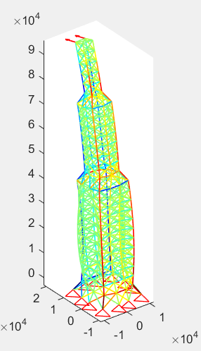
平面桁架与空间桁架有限元代码异同
%局部坐标与全局坐标的转换函数
function [R]=CoordTransform(x,y,BarLength)
l=(x(2)-x(1))/BarLength; m=(y(2)-y(1))/BarLength;
R=[l m 0 0;0 0 l m];
end
%局部坐标与全局坐标的转换函数
function [R]=CoordTransform(x,y,z,BarLength)
l=(x(2)-x(1))/BarLength; m=(y(2)-y(1))/BarLength;n=(z(2)-z(1))/BarLength;
R=[l m n 0 0 0;0 0 0 l m n];
end
%2D/3D索引的区别
%整体刚度矩阵组装
K(3*n1-2:3*n1,3*n1-2:3*n1)=K(3*n1-2:3*n1,3*n1-2:3*n1)+ke(1:3,1:3);
K(3*n1-2:3*n1,3*n2-2:3*n2)=K(3*n1-2:3*n1,3*n2-2:3*n2)+ke(1:3,4:6);
K(3*n2-2:3*n2,3*n1-2:3*n1)=K(3*n2-2:3*n2,3*n1-2:3*n1)+ke(4:6,1:3);
K(3*n2-2:3*n2,3*n2-2:3*n2)=K(3*n2-2:3*n2,3*n2-2:3*n2)+ke(4:6,4:6);
%绘制杆件/结果后处理
for i=1:length(ele(:,1))
plot3([x(ele(i,2)),x(ele(i,3))],[y(ele(i,2)),y(ele(i,3))],[z(ele(i,2)),z(ele(i,3))],...
LineStyle,'LineWidth',LineWidth*ele(i,4)/max(ele(:,4)));
hold on
end
%施加约束--乘大数法
for iConstr=1:size(Constr,1)
for j=2:4
if ~isnan(Constr(iConstr,j))
K(3*Constr(iConstr,1 )+j-4,3*Constr(iConstr,1)+j-4)=...
1e12*K(3*Constr(iConstr,1 )+j-4,3*Constr(iConstr,1)+j-4);
F(3*Constr(iConstr,1)+j-4)=1e12*Constr(iConstr,j)*...
K(3*Constr(iConstr,1 )+j-4,3*Constr(iConstr,1)+j-4);
……

